Slide 1
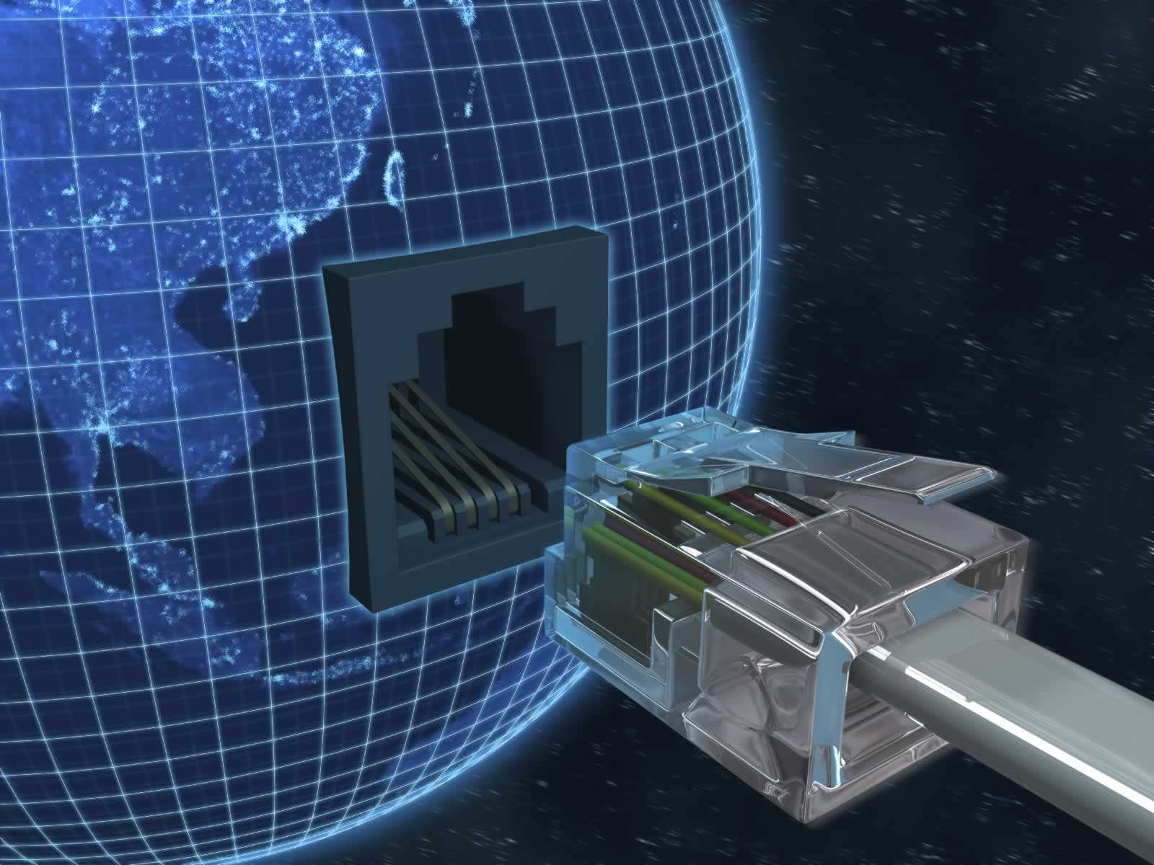
Information Technology Infrastructure
Chapter 7
Telecommunications, the Internet and Wireless Technologies
MFIS
Lisa Murphy
Notes:
1

Slide 2

Learning Objectives
Identify the principal components of telecommunications networks and key networking technologies.
Describe the main telecommunications transmission media and types of networks.
Explain how the Internet and Internet technology work and how they support communication and e-business.
Identify the principal technologies and standards for wireless networking, communication, and Internet access.
Assess the value to business of radio frequency identification (RFID) and wireless sensor networks.
Notes:
This chapter discusses the role of databases for managing a firm’s data and providing the foundation for business intelligence. Ask students to describe any databases they have encountered or used at work or in their personal use on the Web. (For example, Google and Amazon are database driven web sites, as are travel reservation web sites, MySpace, Facebook. And, of course, iTunes) Ask students why these sites are driven by databases – what is it about databases that makes the creation and use of these sites more efficient.

Slide 3

Virgin Megastores Keeps Spinning with Unified Communications
Problem:
1400 employees in 11 retail locations; slow resolutions of business issues because of cost of conference calls
Solutions:
Implement unified communications to integrate voice mail, e-mail, conference calling, instant messaging
Microsoft’s Office Communication Server, Office Communicator, RoundTable conferencing and collaboration tools
Demonstrates IT’s role in hastening communication and flow of information
Notes:
The opening case discusses Virgin Megastore’s implementation of unified communications. Ask students what the business value is of improved, faster communication between employees is? Is this a quantifiable benefit?
3

Slide 4

Telecommunications and Networking in Today’s Business World
Networking and communication trends
Convergence:
Telephone networks and computer networks converging into single digital network using Internet standards
Cable companies providing voice service
Broadband:
More than 60% of U.S. Internet users have broadband access
Broadband wireless:
Voice and data communication as well as Internet access are increasingly taking place over broadband wireless platforms
Notes:
Here we are looking at recent developments in networking technologies. Ask students to give an example of convergence. How fast is broadband today? Do all of the students have broadband. Note that in 2000, typical Internet access speeds were 56 kbps over a telephone line, costing 25 cents per kilobit, while today broadband speeds are 1 mbps, costing 1 cent per kilobit.
4

Slide 5
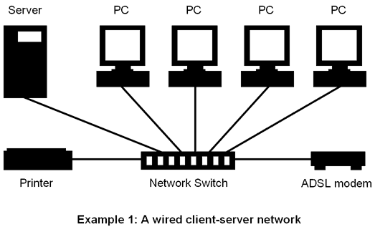
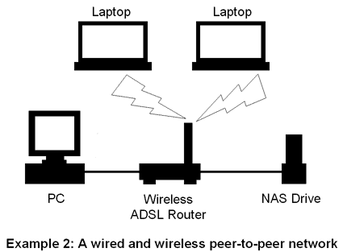
What is a computer network?
Two or more connected computers
Major components in simple network
Client computer
Server computer
Network interfaces (NICs)
Connection medium
Network operating system
Hub or switch
Router
Notes:
This slide describes what a network is along with the components that you will find in a simple network (illustrated on the next slide.)
Ask students to describe the function of a NIC. What is a connection medium? Ask students to describe the purpose of a hub, switch, and router.
5

Slide 6
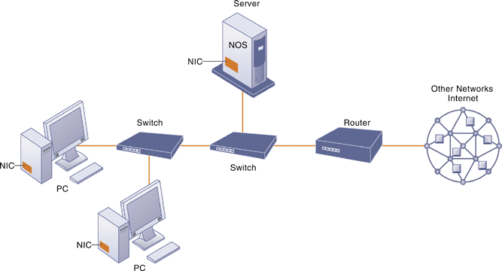
Components of a Simple Computer Network
Illustrated here is a very simple computer network, consisting of computers, a network operating system residing on a dedicated server computer, cabling (wiring) connecting the devices, network interface cards (NIC), switches, and a router.
Notes:
This graphic illustrates the components of a simple network. While the NOS is shown as part of the server, note that, depending on the type of software, an NOS may also be designed to reside on client computers. Do some students have a home computer network? Ask them to describe the elements of the network.
6

Slide 7
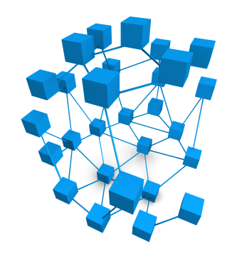
Networks in large companies
Components can include:
Hundreds of local area networks (LANs) linked to firmwide corporate network
Various powerful servers
Web site
Corporate intranet, extranet
Backend systems
Mobile wireless LANs (Wi-Fi networks)
Videoconferencing system
Telephone network
Wireless cell phones
Notes:
A local area network (LAN) is a computer network that user interconnects computers in a limited area such as a home, school, computer laboratory, or office building using network media
Back end systems are corporate systems that are used to run a company such as systems to manage orders, inventory and supply processing
This slide looks at the additional components one might expect to find in the network of a large company that has many locations and thousands of employees (illustrated on the next slide). Ask students what is meant by “backend systems.” Note that many firms are dispensing with traditional telephone networks and using Internet telephones that run on existing data networks.
7

Slide 8
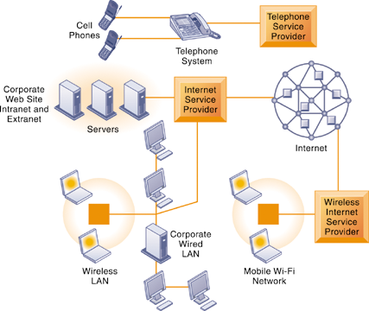
Corporate Network Infrastructure
Today’s corporate network infrastructure is a collection of many different networks from the public switched telephone network, to the Internet, to corporate local area networks linking workgroups, departments, or office floors.
Notes:
This graphic illustrates the components of a large company’s network. Note the difference between the wireless LAN, which allows wireless access within the office, and the mobile Wi-Fi network, which allows Internet access to employees outside of offices.
8

Slide 9
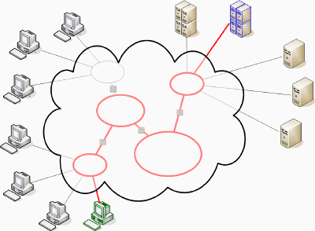
Key digital networking technologies
Client/server computing
Distributed computing model
Clients linked through network controlled by network server computer
Server sets rules of communication for network and provides every client with an address so others can find it on the network
Has largely replaced centralized mainframe computing
The Internet:
Largest implementation of client/server computing
Notes:
This slide and following two slides look at the main technologies in use today for networks: client/server computing, packet switching, and TCP/IP. Ask students what advantages client/server computing has over centralized mainframe computing.
9

Slide 10
Packet switching
Method of slicing digital messages into parcels (packets), sending packets along different communication paths as they become available, and then reassembling packets at destination
Previous circuit-switched networks required assembly of complete point-to-point circuit
Packet switching more efficient use of network’s communications capacity
Notes:
This slide continues the discussion of the three main networking technologies today, looking at the second, packet switching. Note that circuit-switched networks were expensive and wasted available communications capacity – the circuit had to be maintained whether data was being sent or not. It is also important to note that packet switching enables packets to follow many different paths. What is the advantage of this capability?
10

Slide 11
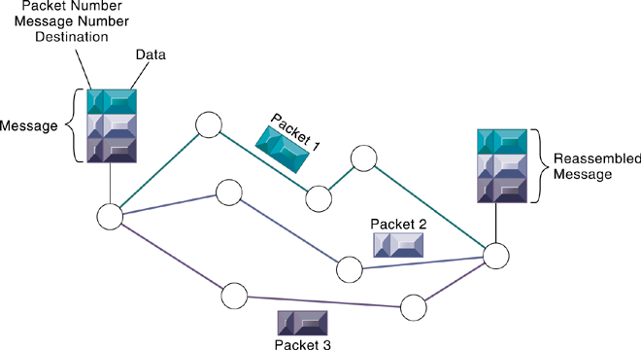
Packet-Switched Networks and Packet Communications
Data are grouped into small packets, which are transmitted independently over various Communications channels and reassembled at their final destination.
Notes:
This graphic illustrates how packet switching works, showing a message being split into three packets, sent along different routes, and then reassembled at the destination. Note that each packet contains a packet number, message number, and destination.
11

Slide 12
TCP/IP and connectivity
Connectivity between computers enabled by protocols
Protocols: Rules that govern transmission of information between two points
Transmission Control Protocol/Internet Protocol (TCP/IP)
Common worldwide standard that is basis for Internet
Department of Defense reference model for TCP/IP
Four layers
Application layer
Transport layer
Internet layer
Network interface layer
Notes:
Web browsers use TCP when they connect to servers on the World Wide Web,
The three main networking technologies in use today, and looks at the third TCP/IP. Note that in a network, there are typically many different types of hardware and software components that need to work together to transmit and receive information. Different components in a network communicate with each other only by adhering to a common set of rules called protocols. In the past, many diverse proprietary and incompatible protocols often forced business firms to purchase computing and communications equipment from a single vendor. But today corporate networks are increasingly using a single, common, worldwide standard called Transmission Control Protocol/
Internet Protocol (TCP/IP). TCP/IP actually is a suite of protocols, the main ones of which are TCP and IP. Ask students what these two main protocols are responsible for.
12

Slide 13
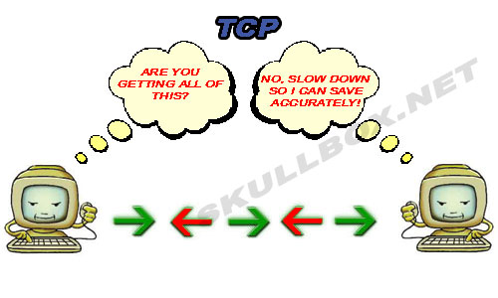
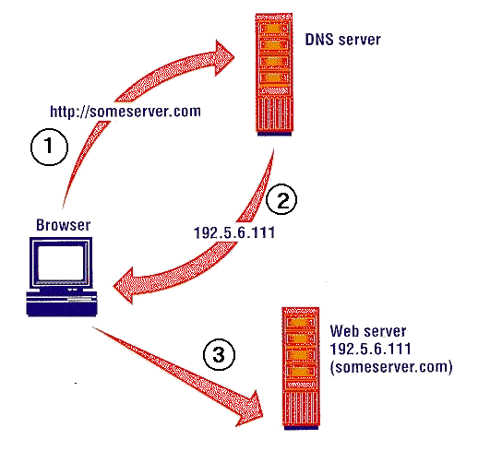
DNS and TCP/IP
Define an address
TCP/IP will make:
A call out to a DNS-server, asking for the IP of someserver.com
The DNS server will reply with the IP-address (in this example 192.5.6.111)
TCP/IP now makes the connection to the requested server someserver.com, using the IP-address 192.5.6.111
Notes:
The Domain Name System (DNS) is a hierarchical distributed naming system for computers, services, or any resource connected to the Internet or aprivate network.

Slide 14
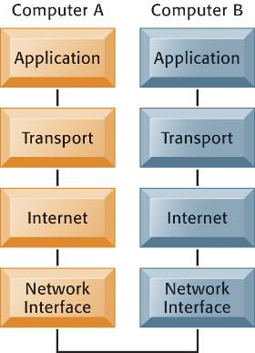
The Transmission Control Protocol/Internet Protocol (TCP/IP) Reference Model
Application Layer:
Enable client application programs to access the other layers, and defines the protocols that applications use to exchange data, eg HTTP
Transport Layer:
Provides application layer with communication services, eg TCP
Internet Layer:
Responsible for addressing, routing, and packaging data packets called IP datagrams
Network Interface Layer:
Responsible for placing packets on and receiving them from the network
Notes:
This graphic illustrates the four layers of the DOD reference model for TCP/IP. Note that what happens, when computer A sends a message to computer B, is that the data that computer A creates is transferred within that computer from the application layer to subsequent layers in sequence. In this process it is split into packets, and information is added at each stage, ultimately translating the packets into a form that can be transferred over the network interface. After traveling over the network interface, the packets are reassembled at the recipient computer, from the network interface layer up, ultimately for use by the application layer.
14

Slide 15
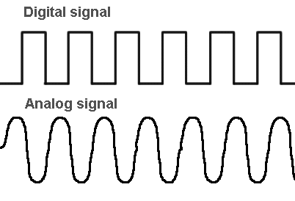
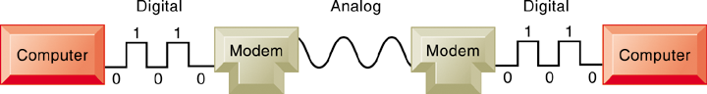
Communications Networks
Signals:
Digital vs. analog
Modem: Translates digital signals into analog form
Notes:
Analog and digital signals are used to transmit information, usually through electric signals. In both these technologies, the information, such as any audio or video, is transformed into electric signals.
The difference between analog and digital technologies is that in analog technology, information is translated into electric pulses of varying amplitude. In digital technology, translation of information is into binary format (zero or one) where each bit is representative of two distinct amplitudes.
Note that a network can be defined by the way the clients interact (client/server vs. peer-to-peer); the type of physical medium to carry signals (Ethernet, Fast Ethernet, etc.), and the way in which computers are connected and send signals to each other (topology).
This slide looks at the types of networks that organizations use.
Ask students what the differences are between digital and analog signals. Ask students to describe the range of LANs, CANs, WANs, and MANs.
15

Slide 16
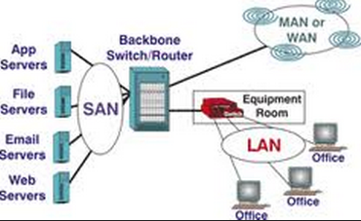
Types of networks
Local-area networks (LANs)
Client/server or peer-to-peer
Up to 500 metres (an office of floor of a building)
Topologies: star, bus, ring
Campus-area networks (CANs)
Up to 1,000 metres (a college campus or corporate facility)
Metropolitan-area networks (MANs)
A city or metropolitan area
Wide-area networ (WANs)
A transcontinental or global area
Notes:
This slide looks at the types of networks that organizations use.
Ask students what the differences are between digital and analog signals. Ask students to describe the range of LANs, CANs, WANs, and MANs.
Note that a network can be defined by the way the clients interact (client/server vs. peer-to-peer); the type of physical medium to carry signals (Ethernet, Fast Ethernet, etc.), and the way in which computers are connected and send signals to each other (topology).
16

Slide 17
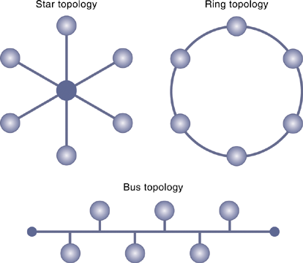
Network Topologies
The three basic network topologies are the bus, star, and ring.
Notes:
This graphic illustrates the three main topologies in use in LANs. In a star topology, all devices on the network connect to a single hub and all network traffic flows through the hub. In an extended star network, multiple layers or hubs are organized into a hierarchy. In a bus topology, one station transmits signals, which travel in both directions along a single transmission segment. All of the signals are broadcast in both directions to the entire network. All machines on the network receive the same signals, and software installed on the client’s enables each client to listen for messages addressed specifically to it. A ring topology connects network components in a closed loop. Messages pass from computer to computer in only one direction around the loop, and only one station at a time may transmit. The ring topology is primarily found in older LANs using Token Ring networking software. Ask students which of the topologies is the most common.
17

Slide 18
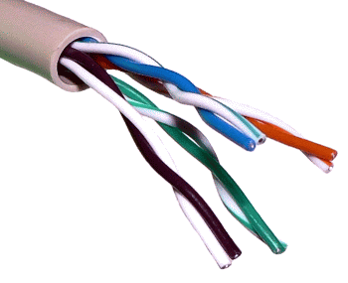
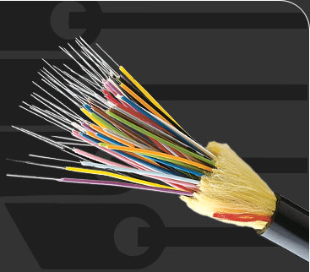
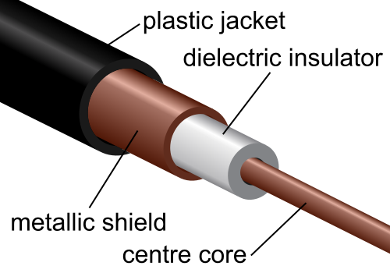
Transmission Media
Twisted wire
Fiber optics
Coaxial cable
Notes:
This slide looks at the media involved in network transmission. Note that many of the telephone systems in buildings had
twisted wires installed for analog communication, but they can be used for digital communication as well. Also, today, telecommunications companies are starting to bring fiber optic cable into the home for high-speed Internet access.
18

Slide 19
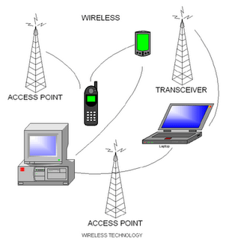
Transmission Media
Wireless transmission media and devices
Microwave
Satellites
Cellular telephones
Transmission speed
PS – bits per second
Hertz
Bandwidth
Notes:
Ask students what characteristic of microwave transmission means that transmission stations must be 37 miles apart.
Note that the transmission capacity of a medium (bps) is dependent on its frequency, which is measured in hertz, or cycles per second. Ask students to define bandwidth (it is the difference between the highest and lowest frequencies that can be accommodated on a single channel.)
19

Slide 20
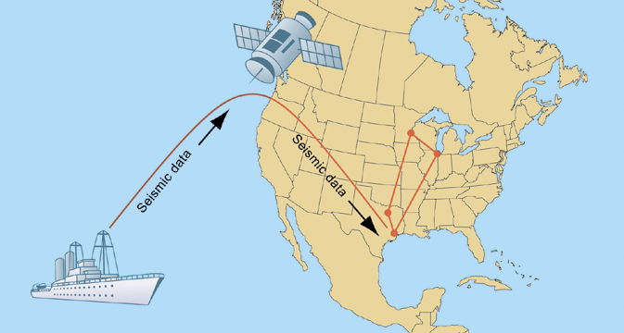
BP Amoco’s Satellite Transmission System
Communication satellites help BP Amoco transfer seismic data between oil exploration ships and research centers in the United States.
Notes:
Petroleum industry company
This graphic looks at the use of satellites by BP Amoco to transmit seismic data from exploration ships to research centers.
20

Slide 21
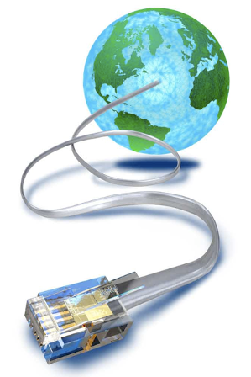
The Global Internet
What is the Internet?
Connecting to the Internet
Internet service providers (ISPs)
Services
DSL, cable, satellite, T lines (T1, T3)
Internet addressing and architecture
IP addresses
The domain name system
Hierarchical structure
Top-level domains
Notes:
This slide examines what the Internet is – ask students to describe it and what they use it for. The text calls it the most extensive public communication system and the world’s largest implementation of client/server computing.
Ask students how they connect to the Internet. Do any of their families use dial-up (telephone/modem). Do any use satellite? Note that T lines are leased, dedicated lines suitable for businesses or government agencies requiring high-speed guaranteed service levels.
Ask students what an IP address is used for. Note that the domain name system makes it possible for people to remember addresses.
21

Slide 22
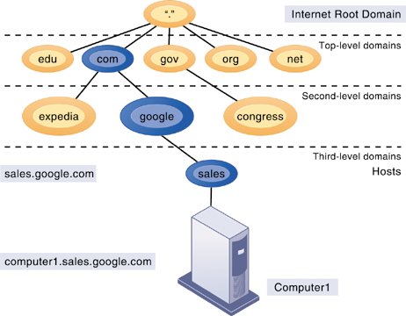
The Domain Name System
The Domain Name System is a hierarchical system with a root domain, top-level domains, second-level domains, and host computers at the third level.
Notes:
This graphic describes how the domain name system works. Note that the “root” domain is the period that is used before the top-level domain, such as .edu or .com. Give students an example Internet address, such as myserver.myspace.com and ask them what the top, second-, and third-level domains are.
22

Slide 23

Generic Top Level Domains (gTLD)
gTLD | intended use
.aero | the air transport industry.
.arpa | reserved exclusively to support operationally-critical infrastructural identifier spaces
.asia | companies. organisations and individuals in the Asia-Pacific region
.biz | business use
.cat | Catalan language/culture
.com | commercial organizations, but unrestricted
.coop | cooperatives
.edu | post-secondary educational establishments
.gov | government entities within the United States at the federal, state, and local levels
.info | informational sites, but unrestricted
.int | international organizations established by treaty
.jobs | employment-related sites
.mil | the U.S. military
.mobi | sites catering to mobile devices
.museum | museums
.name | families and individuals
.net | originally for network infrastructures, now unrestricted
.org | originally for organizations not clearly falling within the other gTLDs, now unrestricted
.pro | certain professions
.tel | services involving connections between the telephone network and the Internet (added March 2, 2007)
.travel | travel agents, airlines, hoteliers, tourism bureaus, etc.

Slide 24
Internet Architecture and Governance
Internet Architecture
Trunk lines (backbone networks)
Regional networks
ISPs
Internet Governance
No formal management
Policies established by professional, government organizations
IAB, ICANN, W3C
The Future Internet
IPv6
Internet2, NGI
Notes:
This slide continues the discussion about the Internet and what it is, looking at the structure of the Internet’s networks and the organizations that help manage the Internet.
Ask students who owns the trunk lines and regional networks.
Note that the Internet governance organizations influence government agencies, network owners, ISPs and software developers with the goal of keeping the Internet operating as efficiently as possible. The Internet must also conform to the laws of the nations in which it operates, as well as the technical infrastructures that exist within the nations. Ask students if they know which organization assigns IP addresses (ICANN).
Note that the IP addresses currently in use, such as 208.55.112.34 are part of a specification called IP v 5. However, given the growth rate of the Internet, there aren’t enough IP addresses in this scheme to last beyond 2013. IP v 6 is a revised addressing convention that will provide over a quadrillion addresses.
Ask students what types of technologies Internet 2 is working on (improved routing, different service levels, applications for distributed computing, virtual laboratories, distributed learning, digital libraries, tele-immersion.)
IAB – Internet Architecture Board
ICANN – Internet Corporation for Assigned names and Numbers
W3C – World Wide Web Consortium
NGI – Next Generation Internet
24

Slide 25
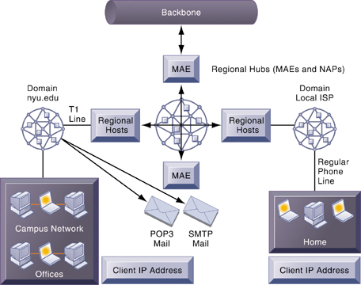
Internet Network Architecture
The Internet backbone connects to regional networks, which in turn provide access to Internet service providers, large firms, and government institutions.
Network access points (NAPs) and metropolitan area exchanges (MAEs) are hubs where the backbone intersects regional and local networks and where backbone owners connect with one another.
Notes:
This graphic illustrates the architecture of the Internet. Note that MAEs (metropolitan area exchanges) are hubs where the backbone intersects regional and local networks and where backbone networks connect with one another.
25

Slide 26

Internet Services
Internet services
E-mail
Chatting and instant messaging
Newsgroups
Telnet
File Transfer Protocol (FTP)
World Wide Web
Voice over IP (VoIP)
Unified communications
Virtual private networks (VPNs)
Notes:
This slide continues the discussion about what the Internet is, here looking at the services, or applications, that the Internet supports. Notice that the Internet comprises many more services than just e-mail and the Web. Ask students which of these services, beyond e-mail and the WWW have they used, and if they have, to describe how it works.
Other popular technologies that use the Internet as a platform are VoIP, unified communications, and virtual private networks. Ask students what the value to business is of each of these technologies.
Unified Communications – merge disparate modes of communication into a single universally accessible service
26

Slide 27
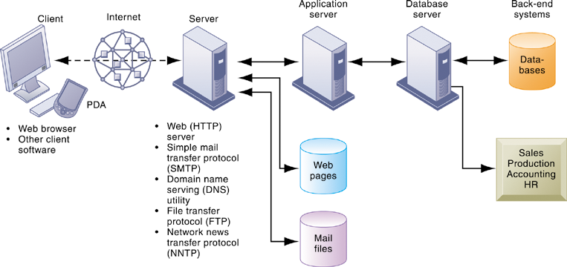
Client/Server Computing on the Internet Accessing Services
Client computers running Web browser and other software can access an array of services on servers over the Internet. These services may all run on a single server or on multiple specialized servers.
Notes:
This graphic looks at the services that an Internet server computer can offer: Web sites (HTTP), e-mail (SMTP), file transfer (FTP), newsgroups (NNTP). It illustrates where on the path between client and back-end systems these services lie.
27

Slide 28
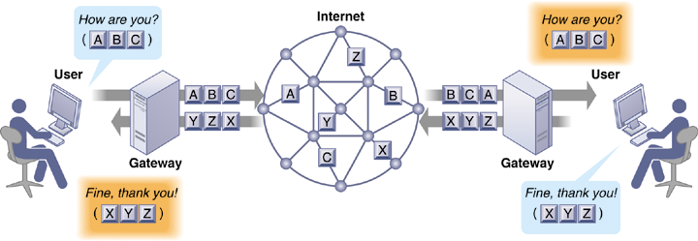
How Voice over IP Works
An VoIP phone call digitizes and breaks up a voice message into data packets that may travel along different routes before being reassembled at the final destination. A processor nearest the call’s destination, called a gateway, arranges the packets in the proper order and directs them to the telephone number of the receiver or the IP address of the receiving computer.
Notes:
This graphic shows how VoIP works. The voice messages are digitized and transported over the Internet in the same packet-switching method as traditional Internet data. It requires special processors called gateways to translate the voice data.
28

Slide 29
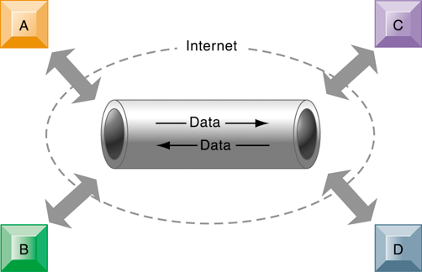
A Virtual Private Network Using the Internet
This VPN is a private network of computers linked using a secure “tunnel” connection over the Internet.
It protects data transmitted over the public Internet by encoding the data and “wrapping” them within the Internet Protocol (IP).
By adding a wrapper around a network message to hide its content, organizations can create a private connection that travels through the public Internet.
Notes:
This graphic illustrates how a virtual private network works. The rectangles A, B, C, and D represent different computers on the VPN. In a process
called tunneling, packets of data are encrypted and wrapped inside IP packets. By adding this wrapper around a network message to hide its content, business firms create a private connection that travels through the public Internet.
29

Slide 30
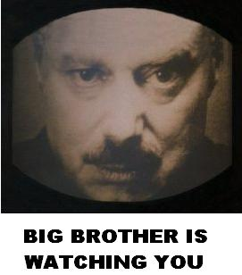

Monitoring Employees on Networks: Unethical or Good Business?
Question Time
Read the Case-Study on Monitoring Employees and answer the following questions:
Should managers monitor employee e-mail and Internet usage? Why or why not?
Describe an effective e-mail and Web use policy for a company.
Notes:
This Interactive Session looks at the management problems that have arisen because of the personal use of e-mail and the Web by employees, from loss of productivity, confidentiality, network traffic issues, and government regulations for maintaining records.
30

Slide 31

Break Time
10 Minutes break!!

Slide 32

The World Wide Web
HTML (Hypertext Markup Language)
Formats documents for display on Web
Hypertext Transfer Protocol (HTTP)
Communications standard used for transferring Web pages
Uniform resource locators (URLs)
Addresses of Web pages
Web servers
Software for locating and managing Web pages
Notes:
This slide looks at one of the most popular services on the Internet, the Web, and the main protocols enabling the Web. The Web is an interlinked connection of Web sites, which are collections of Web pages linked to a home page. These pages are programmed using HTML, and transmitted to user’s Web browsers by HTTP. Web page addresses (URLs) are composed of the domain name of the web site and the file location of the individual web page. Ask students if any have programmed Web pages using HTML, and if so, to describe what this is like. How have they made the Web pages visible to others on the Web?
32

Slide 33

Searching for Information on the Web
Search engines
Started in early 1990s as relatively simple software programs using keyword indexes
Today, major source of Internet advertising revenue via search engine marketing, using complex algorithms and page ranking techniques to locate results
Sponsored links vs. organic search results (unsponsored)
Shopping bots
Use intelligent agent software for searching Internet for shopping information
Notes:
This slide looks at how people find information of interest on the Web. The primary method is through search engines, which today act as major portals to the Web. Ask students where their initial points of entry are on the Web, and how they find information they are interested in.
The text discusses how big the Web is, in terms of pages. Google visited 50 billion web pages in 2007, but this doesn’t include the “deep Web.” Ask students what the “deep Web” is. Web pages a available only to subscribers for a fee (“premium content”) do not allow crawlers to index the pages.
33

Slide 34
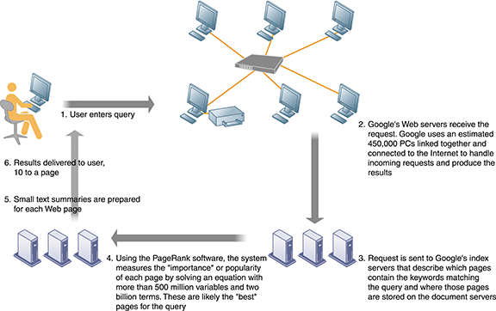
How Google Works
The Google search engine is continuously crawling the Web, indexing the content of each page, calculating its popularity, and storing the pages so that it can respond quickly to user requests to see a page. The entire process takes about one-half second.
Notes:
This graphic illustrates how Google works. At the foundation of Google’s search engine are two concepts – page ranking and the indexing of combinations of words. Ask students if they have a favorite search engine, and if so, why that search is their favorite.
34

Slide 35
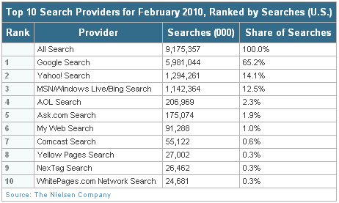
Major Web Search Engines
http://blog.nielsen.com/nielsenwire/online_mobile/nielsen-reports-february-2010-u-s-search-rankings/
Google is the most popular search engine on the Web, handling 65.2 percent of all Web searches.
Notes:
This graphic ranks the major search engines according to popularity, or percentage of total number of searches performed. Google is a clear favorite. Is this due to the superiority of their search engine or does it involve other factors?
35

Slide 36

Web 2.0 – The Read/Write Web
Web 2.0: Second-generation interactive Internet-based services enabling people to collaborate, share information, and create new services online
Cloud computing
Software mashups and widgets
Blogs: Chronological, informal Web sites created by individuals using easy-to-use weblog publishing tools
RSS (Really Simple Syndication): Syndicates Web content so aggregator software can pull content for use in another setting or viewing later
Wikis: Collaborative Web sites where visitors can add, delete, or modify content on the site
Notes:
This slide discusses Web 2.0 services. Software mashups and widgets were discussed in Chapter 5.
Ask if students use a blog reader, such as Google Reader, to read their blogs. If they have, they have used RSS to pull in the content from their blogs to read them in one place. Note that wikis are used in business to share information. The text cites the example of Motorola, whose sales reps use wikis to share sales information. Instead of developing a different pitch for each client, reps reuse the information posted on the wiki. How do companies use blogs and RSS?
36

Slide 37
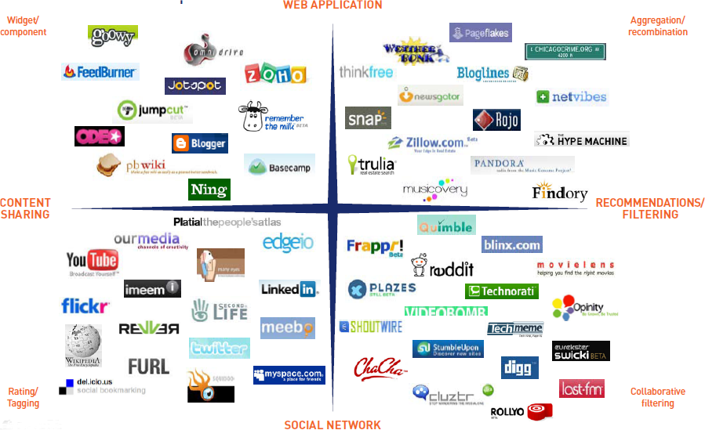
Web 2.0 Landscape
Notes:
From:
http://www.rossdawsonblog.com/Web2_Framework.pdf

Slide 38
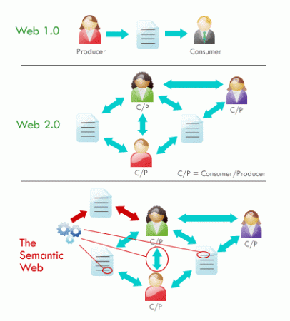
Web 3.0
Current efforts to make using Web more productive
Inefficiency of current search engines: Of 330 million search engine queries daily, how many are fruitful?
Semantic Web
Other, more modest views of future Web
Increase in cloud computing, SaaS
Ubiquitous connectivity between mobile and other access devices
Make Web a more seamless experience
Notes:
This slide discusses the next wave of improving the Web, a collaborative effort to make searching the Web more productive and meaningful for people. The text estimates that 50% of search engine queries produce meaningful results, or an appropriate result in the first three listings. Ask students if it is common for their search engine results to produce what they are looking for in the first three results. The text cites the example of searching for Paris Hilton versus Hilton in Paris. Both these searches produce similar results, because the computer does not understand the difference between these two concepts. In a more semantic Web, the difference would be understood.
38

Slide 39
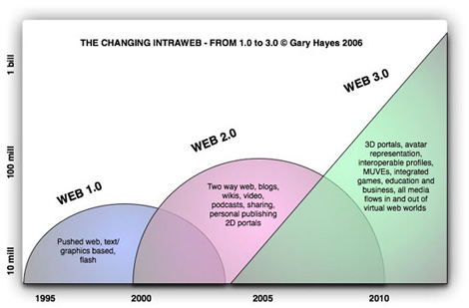
Web 3.0 – The Semantic Web
Collaborative effort to add layer of meaning on top of Web, to reduce the amount of human involvement in searching for and processing Web information
Notes:
The Semantic Web is an evolving development of the World Wide Web in which the meaning (semantics) of information and services on the web is defined, making it possible for the web to "understand" and satisfy the requests of people and machines to use the web content

Slide 40
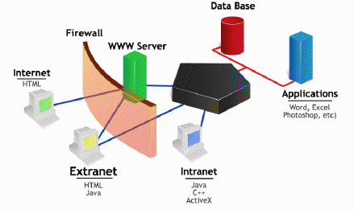
Intranets and Extranets
Intranets
Use existing network infrastructure with Internet connectivity standards software developed for the Web
Create networked applications that can run on many types of computers
Protected by firewalls
Extranets
Allow authorized vendors and customers access to an internal intranet
Used for collaboration
Also subject to firewall protection
Notes:
This slide discusses the use of Internet standards and Web technologies within the firm to create intranets and extranets. Ask students how what the value to businesses is for both. (Both intranets and extranets reduce operational costs by providing the connectivity to coordinate disparate business processes within the firm and to link electronically to customers and suppliers. Extranets often are employed for collaborating with other companies for supply chain management, product design and development, and training efforts.)
40

Slide 41

The Wireless Revolution
Wireless devices
PDAs, BlackBerry, smart phones
Cellular systems
Competing standards for cellular service
United States: CDMA
Most of rest of world: GSM
Third-generation (3G) networks
Higher transmission speeds suitable for broadband Internet access
Notes:
This slide discusses the continuing revolution in wireless communication. Ask students what changes or improvements have happened in their cell phone service over the past two years. Have they purchased or upgraded a cell phone in that time, and if so, why?
Note that “3G networks are widely used in Japan, South Korea, Taiwan, Hong Kong, Singapore, and parts of northern Europe, but such services are not yet available in many U.S. locations. To compensate, U.S. cellular carriers have upgraded their networks to support higher-speed transmission. These interim 2.5G networks provide data transmission rates ranging from 60 to 354 Kbps, enabling cell phones to be used for Web access, music downloads, and other broadband services.” How many students are using 3G phones? The next complete evolution in wireless communication, termed 4G, will be entirely packet-switched and capable of providing between 1 Mbps and 1 Gbps speeds, with premium quality and high security.
41

Slide 42

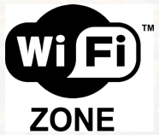
Wireless computer networks and Internet access
Bluetooth (802.15)
Links up to 8 devices in 10-m area using low-power, radio-based communication
Useful for personal networking (PANs)
Wi-Fi (802.11)
Set of standards: 802.11a, 802.11b, 802.11g, 802.11n
Used for wireless LAN and wireless Internet access
Use access points: Device with radio receiver/transmitter for connecting wireless devices to a wired LAN
Notes:
This slide discusses the current standards in wireless networking. Ask students if they have any Bluetooth or wireless devices they use for computing. Note that in most Wi-Fi communications, wireless devices communicate with a wired LAN using an access point.
42

Slide 43
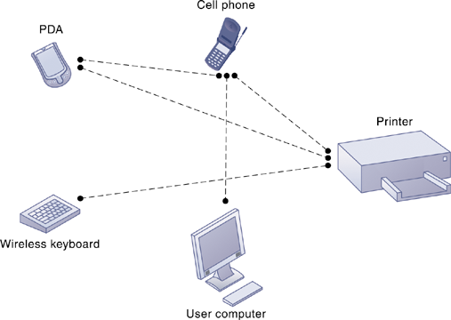

A Bluetooth Network (PAN)
Bluetooth enables a variety of devices, including cell phones, PDAs, wireless keyboards and mice, PCs, and printers, to interact wirelessly with each other within a small 30-foot (10-meter) area.
Notes:
This graphic illustrates the uses of Bluetooth for a PAN. Bluetooth connects wireless keyboards and mice to PCs or cell phones to earpieces without wires. Bluetooth has low-power requirements, making it appropriate for battery-powered handheld computers, cell phones, or PDAs.
In addition to the links shown, Bluetooth can be used to network similar devices to send data from one PC to another, for example.
43

Slide 44
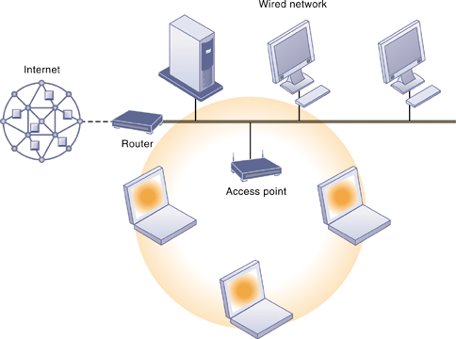
An 802.11 Wireless LAN
Mobile laptop computers equipped with wireless network interface cards link to the wired LAN by communicating with the access point.
The access point uses radio waves to transmit network signals from the wired network to the client adapters, which convert them into data that the mobile device can understand.
The client adapter then transmits the data from the mobile device back to the access point, which forwards the data to the wired network.
Notes:
This graphic illustrates an 802.11 wireless LAN operating in infrastructure mode that connects a small number of mobile devices to a larger wired LAN. Most wireless devices are client machines. The servers that the mobile client stations need to use are on the wired LAN. The access point controls the wireless stations and acts as a bridge between the main wired LAN and the wireless LAN. (A bridge connects two LANs based on different technologies.) The access point also controls the wireless stations.
44

Slide 45

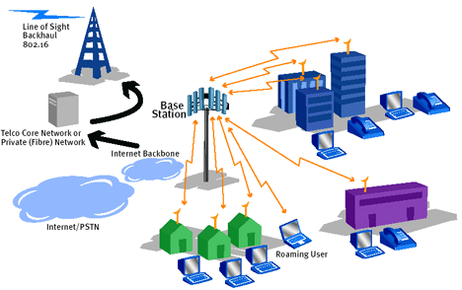

Wireless computer networks and Internet access
Wi-Fi (cont.)
Hotspots: One or more access points in public place to provide maximum wireless coverage for a specific area
Weak security features
WiMax (802.16)
Wireless access range of 50 KM (31 miles)
Require WiMax antennas
Sprint Nextel building WiMax network
Notes:
This slide continues the discussion about wireless networking and Wi-Fi. Ask students if they have ever connected to the Internet through a hotspot at an airport, coffee shop, hotel, or other location. Was there any security?
Ask students what other drawbacks, beside security, there are to Wi-Fi (roaming difficulties, interference). Note that wireless networks based on the upcoming 802.11n specification will solve interference problems by using multiple wireless antennas in tandem to transmit and receive data and technology to coordinate multiple simultaneous radio signals. What is this technology called? (MIMO).
WiMAX, meaning Worldwide Interoperability for Microwave Access
45

Slide 46
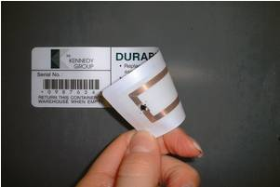
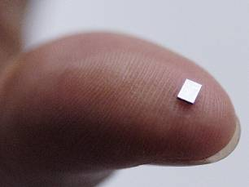
Radio frequency identification (RFID)
Use tiny tags with embedded microchips containing data about an item and location, and antenna
Tags transmit radio signals over short distances to special RFID readers, which send data over network to computer for processing
Active RFID: Tags have batteries, data can be rewritten, range is hundreds of feet, more expensive
Passive RFID: Range is shorter, also smaller, less expensive, powered by radio frequency energy
Notes:
This slide introduces one of two wireless technologies having a major impact on business, radio frequency ID. Ask students for examples of where RFID is used today. The text provides the example of Wal-Mart using RFID to manage inventory and supply chains. Ask students how this works.
46

Slide 47
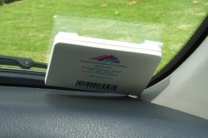
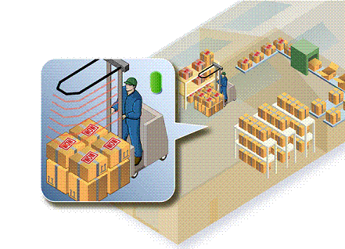
Radio frequency identification (RFID)
Radio frequency identification (RFID)
Common uses:
Automated toll-collection
Tracking goods in a supply chain
Requires companies to have special hardware and software
Reduction in cost of tags making RFID viable for many firms
Notes:
This slide continues the discussion of RFID technology.
While the cost of RFID tags used to be too costly for widespread implementation, today the cost is about 10 cents for a passive tag, so RFID is becoming more cost-effective.
Ask students why special hardware and software is needed to use RFID. (To filter, aggregate, and prevent RFID data from overloading business networks and system applications. ) Also, applications will need to be redesigned to accept massive volumes of frequently generated RFID data and to share those data with other applications. Major enterprise software vendors, including SAP and Oracle-PeopleSoft, now offer RFID-ready versions of their supply chain management applications.
47

Slide 48
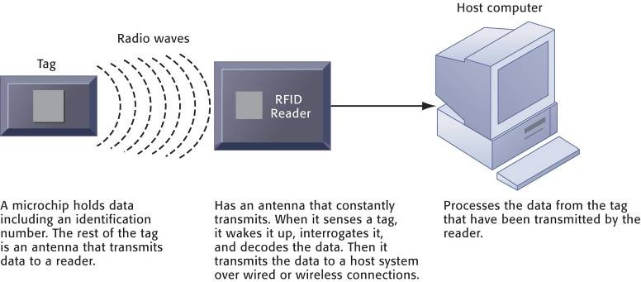
How RFID Works
RFID uses low-powered radio transmitters to read data stored in a tag at distances ranging from 1 inch to 100 feet. The reader captures the data from the tag and sends them over a network to a host computer for processing.
Notes:
This graphic illustrates how RFID works.
Ask students if RFID poses any ethical problems.
48

Slide 49
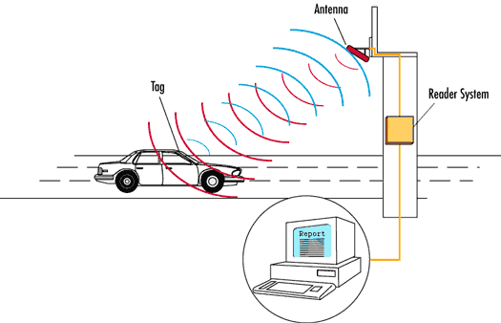
Toll Pass System
Notes:
From:
www.rfid2vin.com/

Slide 50
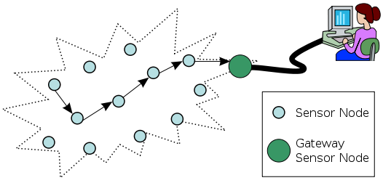
Wireless sensor networks
Wireless sensor networks
Networks of hundreds or thousands of interconnected wireless devices embedded into physical environment to provide measurements of many points over large spaces
Used to monitor building security, detect hazardous substances in air, monitor environmental changes, traffic, or military activity
Devices have built-in processing, storage, and radio frequency sensors and antennas
Require low-power, long-lasting batteries and ability to endure in the field without maintenance
Notes:
This slide introduces a second wireless technology having a major impact on business, wireless sensor networks. Note that the wireless sensors are linked into an interconnected network that routes the data to a computer for analysis.
50

Slide 51
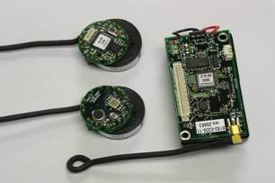
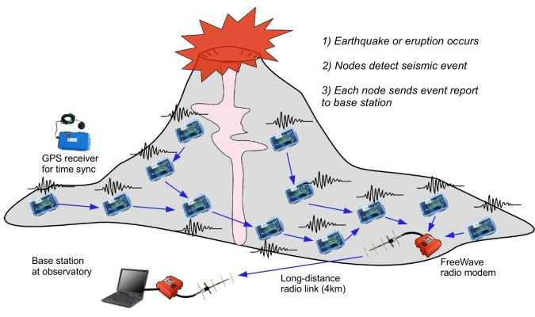
Monitoring Volcanic Eruptions with a Wireless Sensor Network

Slide 52
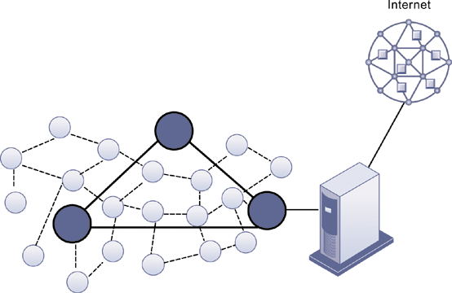
A Wireless Sensor Network
The small circles represent lower-level nodes and the larger circles represent high-end nodes.
Lower-level nodes forward data to each other or to higher-level nodes, which transmit data more rapidly and speed up network performance.
Notes:
This graphic illustrates the lower level notes and higher level nodes at work in a wireless sensor network. Note that the server that data from the sensors is sent to acts as a gateway to a network based on Internet technology.
52

Slide 53
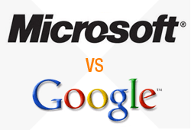
Case-Study – Google vs Microsoft
Read Case-Study in Moodle
Discuss questions at end of Case-Study

Slide 54

E xercise 2 – Double Jeopardy
Notes:
3. Enterprisesystems
6. SCM
Down
DSS
ESS
4. Salesforce
5. TPS

Slide 55

RECAP
To gain an understanding of the following:
Identify the principal components of telecommunications networks and key networking technologies.
Describe the main telecommunications transmission media and types of networks.
Explain how the Internet and Internet technology work and how they support communication and e-business.
Identify the principal technologies and standards for wireless networking, communication, and Internet access.
Assess the value to business of radio frequency identification (RFID) and wireless sensor networks.

